Slide 1
Group 2 Presentation
Chapter 34
THE MEN’S HUT

Slide 2

Summary
Stanley's much-anticipated Task Force meeting, aimed at ensuring the company's excellence, turns out to be disappointing with interruptions during his presentation leading to frustration.
The story emphasizes the importance of patience, and a realistic understanding of corporate dynamics for effective participation in high-level decision-making processes.

Slide 3

(1.Q)"With people like that running The Company, how come it's still in business?"
The Success of Company “Leadership and Perception”
With People Like That Running It.
Stanley’s Perspective
The Men's Hut Concept
Realism in Corporate Management
Developed Organizational Rituals and hierarchies
Commitment and Investment in the System

Slide 4

Understanding the Task Force: A Lesson for Stanley
Stanley’s Preparation
Task Force Meeting Overview
Stanley’s Presentation
Meeting Dynamics
Conclusion
Takeaway for Stanley
Lesson Learned
Key Questions Answered

Slide 5
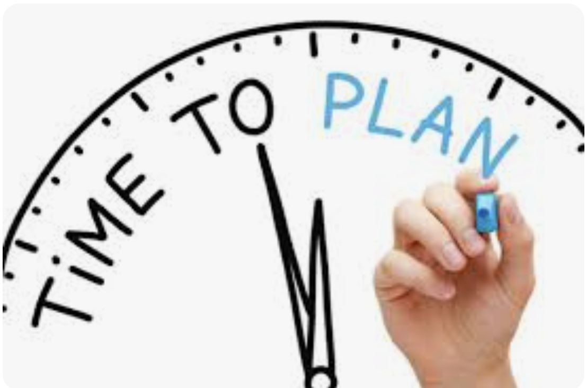
"Optimizing Success: Alternative Approaches for Stanley's Task Force Presentation"
(5.Q) Could Stanley have handled himself any differently at the meeting and thus had different results?
Strategic Arrival and Timing
Adaptable Presentation Style
Effective Question Handling
Confident Expertise Assertion
Strategic Break Engagement
Understanding the Context
Seasoned Participation Insights

Slide 6
Lessons Learned
Expectations
They are Sharpest People in the Company
They are Important
They are Very Busy
They have No time for Nonsense
Their Mission is Very Important
Reality
They are Not Extraordinary
They are Not Indispensable
They are Tired
They Take Their Time
Their Mission is Not Their Main Priority
No one is a Perfect Practitioner at All Times
Faithful
Fair
Devoted
Knowledgeable
Competent
Notes:
Duty of Practitioner
Fairness and Loyalty
Fidelity to Public Needs
Devotion to High Ideals
Knowledge of Relevant Engineering Development
Competency in Performance of Engineering services

